Slide 1
Research of High Gradient Acceleration Technology for Future Accelerators
US/Japan cooperation
11 March, 2013
Toshiyasu Higo (KEK)
Notes:
将来の高電界加速器のための研究開発
日米協力の継続申請

Slide 2
US/Japan cooperation is a key for worldwide collaboration
Asian collab.
US/Japan cooperation is kept the technology base for all!
KEK
Structure fabrication
& test @ Nextef
Tsinghua & IHEP
Structure design
test and analysis
US-Japan
CERN/KEK collaboration
US-HG
CLIC
SLAC conducts
Structure fabrication
High power test
Basic research
CERN financially supports for
Structure fabrication
High power test
System expansion
Prototypes based on from CLIC
Notes:
日米協力 SLAC・KEK 1990年代～
2006年～ CERN Xバンド高電界開発 関わる ＆ 共同研究体制 構築された
最近では、アジアのラボを含めた共同研究を開始
日米での共同研究はその基礎技術を提供
SLAK/KEKの設備、人材、経験 を有効に使って開発発展させることが 今後の展開のキーになっている

Slide 3
Three-year plan proposed in 2011
JFY2011
  KEK prepared basic study environment
  Both labs. continued
    Prototype fabrication TD24R05
    Evaluation T24 and TD24
JFY2012
  Start basic research in a simple geometry
  Test prototype structures
    TD24 and later TD24R05
JFY2013
  Understand the trigger mechanism
  Make rough sketch of high gradient section for LC
Delayed due to klystron failure
Notes:
継続申請の3年間の目標 概略
基礎試験の立ち上げ
複合材料を含めた試験
TWでの可能性 見極め
放電頻度を決める放電のトリガーの理解
100MV/m超の加速ユニットの提案

Slide 4
Extending key activities supported by US-Japan
KEK
  Parts fabrication
  Long-term high gradient test
  Specific tests in simple geometry
SLAC
  Assembly through chemical polishing and heat treatments
  Various specific high power tests
US high gradient collaboration
  Exchange of ideas and experimental results

Slide 5
Who and where cooperation is proceeding
Japan
US
Main lab = KEK
  Accelerator high gradient test
    Nextef
    Shield-B
  Mechanical engineering center
    Structure cell production
    Test sample production
Discussion and information exchange is important
Main lab = SLAC
  NLCTA high gradient test
    High gradient test
  ASTA high gradient test
    Single-cell
    Extremely high power
    Low temperature
  Klystron shop
    Structure fabrication
US-HG collaboration
Notes:
これらの知見を得るためにとってきた体制
SLAC＋KEK の二人三脚 体制 キーポイント
情報の交換の場 US-HG 等との関わりが有効

Slide 6
Last year activities under US-Japan
A pair of TD24R05 prototype structures have been made.
KEK tested one of them. This showed hot cells, where frequent breakdowns occur at particular cells.
Another pair production is in the very final process to be sent to KEK in this month.
Studies in simple geometries were conducted at SLAC.
System for tests with simple geometries was prepared at KEK and waiting for klystron reinstallation.
Parts of test cavity at very high gradient in standing wave was made by KEK and is under assembly at SLAC.
Klystron-based LC idea was discussed at the Higgs factory workshop in US.
Notes:
3年の共同研究で明らかになってきたこと
TW 80MV/m
パルス表面温度上昇

Slide 7
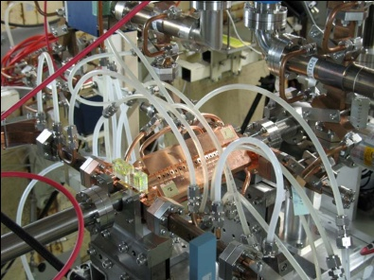
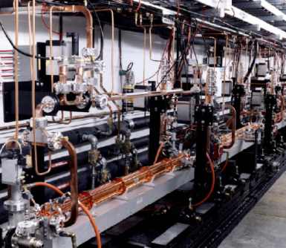
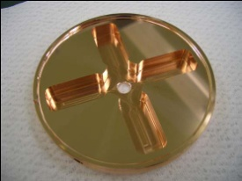
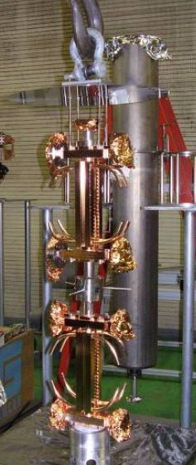
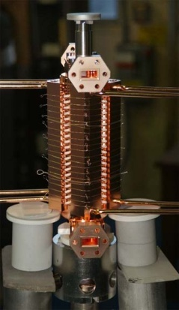
SLAC/KEK test flow (as usual)
Design for CLIC (CERN)
High power test (NLCTA-SLAC)
High power test (Nextef-KEK)
Fabrication of parts (KEK)
CP (SLAC)
VAC bake (SLAC)
Bonding (SLAC)
Notes:
プロトタイプの試験サイクル
ここでも 日米を基礎におく SLAC・KEK キープレーヤー

Slide 8


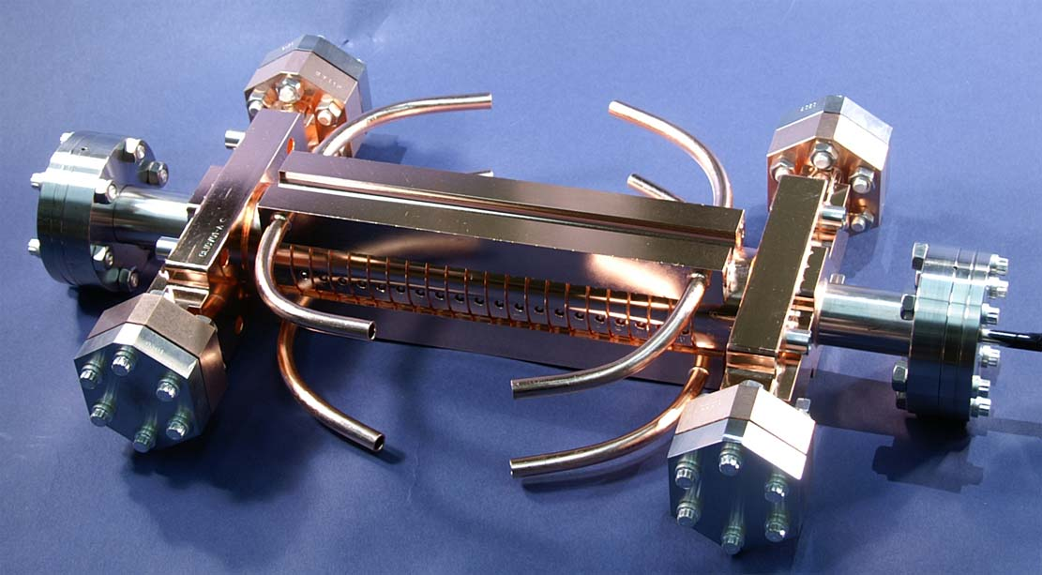
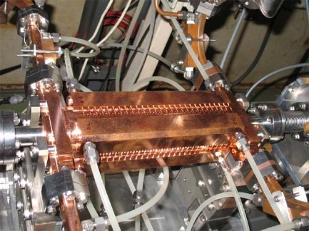

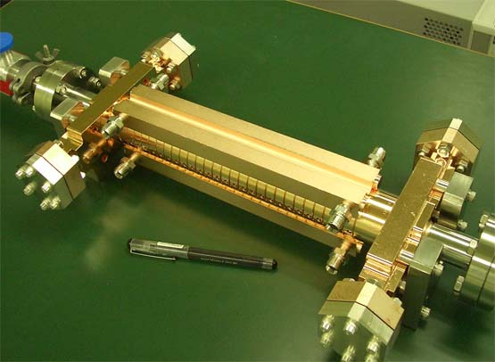
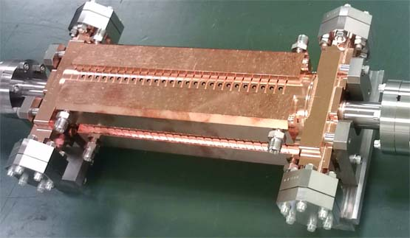
Fabrication and test of LC prototype structures
T18 →TD18→T24→TD24→TD24R05→TD24R05
2009
2013
Under vacuum balking at SLAC to be tested at KEK in April
d
2012
T18_Disk_#2
TD24R05_#4
2010
TD24R05_#2
2011
TD18_Disk_#2
2011-2012
d
d
T24_Disk_#3
TD24_Disk_#4

Slide 9
LC prototype test at Nextef
2008 2009 2010 2011 2012 2013
4 7 10 1 4 7 10 1 4 7 10 1 4 7 10 1 4 7 10 1 4 7 10 1
GLC
KX03 (60cm HDDS)
1
T18_Disk_#2
CLIC prototype tests
1.5
TD18_Quad_#5
Nextef
2
TD18_Disk_#2
3
T24_Disk_#3
4
TD24_Disk_#4
5
TD24R05 #2
Narrow waveguide test
TD24R05 #4?
High power components test
TD24R05(KEK)?
KT1
KT1 to shield-B
Replace klystron
Basic study with simple geometry
Basic studies at shield-B
Shield-B

Slide 10
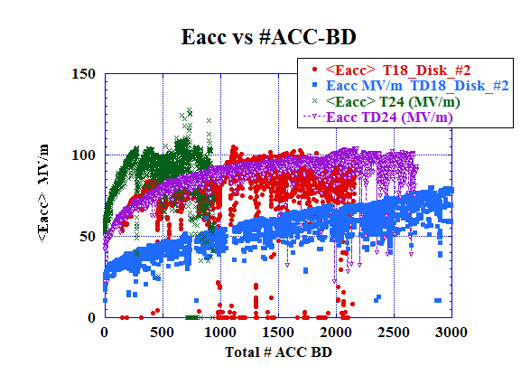
Difference in processing speed among prototype structures
As for number of ACC-BD’s until reaching the nominal level
Speed
→1. T24
→ 2. TD24R05
→ 3. T18
→ 4. TD24
→ 5. TD18
TD24R05
T24
T18
91ns
132ns
51ns
TD24
TD18

Slide 11
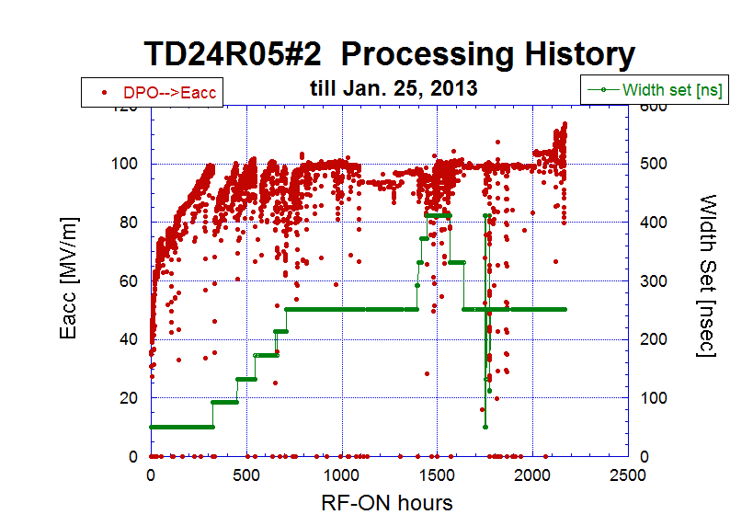
The most recent test on
TD24R05#2 Processing history
Non
BDR increase

Slide 12
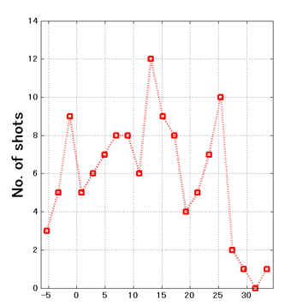
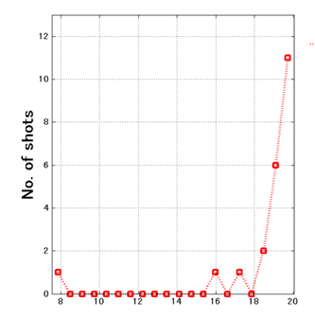
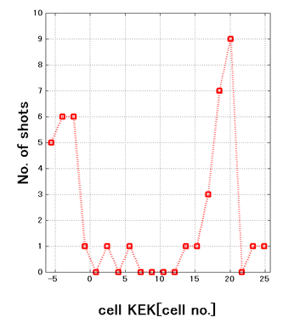
We, KEK, observed hot spots for the first time
Evolution of breakdown cell distribution
Run 11
706—787 hrs
Run 31
2122—2169 hrs
Run 27
1797—1863 hrs
BD cell
No bad cell
Downstream
Upstream

Slide 13
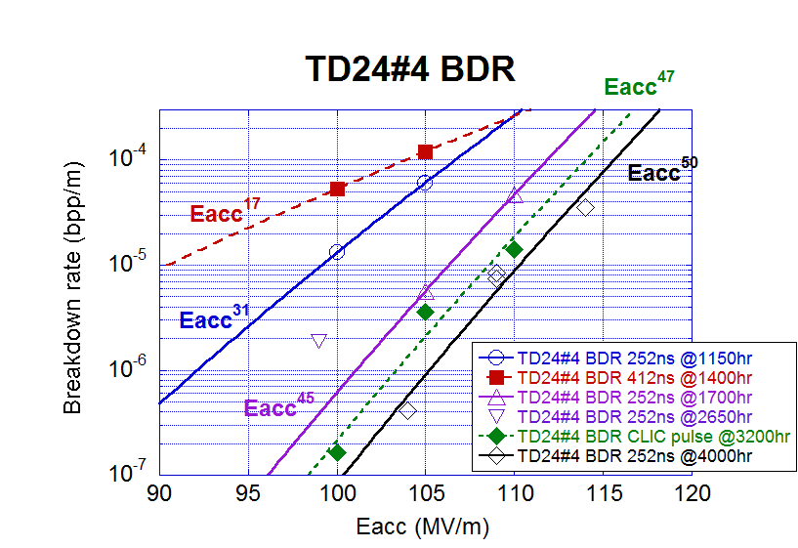
BDR summary on TD24R05
comparing to TD24 and T24
TD24R05#2
(2200-2600hrs)
Seems dominated by hot cell activity
T24#4
(final)

Slide 14
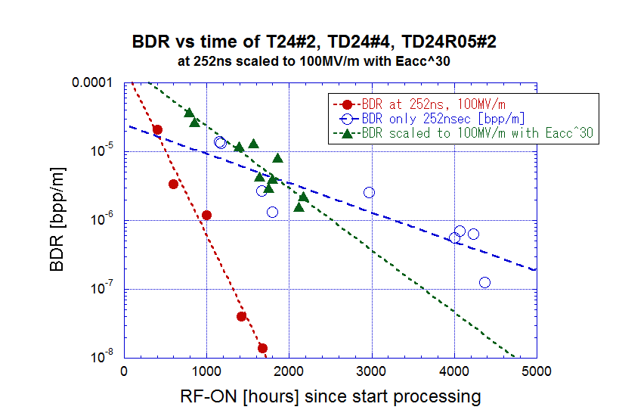
Evolution of breakdown rate
TD24R05
TD24
T24
Undamped T24 is the best.
TD24R05 the same as TD24 in the early stage,
but hot spots appeared and deteriorated.

Slide 15
We need to understand physical mechanism of vacuum arc
Possible and proposed mechanisms
  Dusts and foreign particles → Low work function → FE
  Sharp edge → Es enhancement → FE
  Es → Maxwell’s stress → pull up crystal → FE → plasma development
  Hs → pulse heating → fatigue → edges and ruptures → high Es
  Hs → Pulse heating → Defects in material → Open to surface
  Hs → high current density → electromigration
BD Trigger and evolution to discharge
  Trigger source and frequency decreases, saturated and sometimes increases
  Integrated damage due to discharges should be small

Slide 16
Studies in next stage
Need to understand the physics behind the difference between undamped and damped.
In addition, we need to suppress hot spots.
Here we really need to study and explore the technique for cleaning or clean environment.
This study will be done in tests with simple geometries which is almost ready to go.

Slide 17
Where breakdown triggers come from
high magnetic field area?
Inclusion of foreign materials
High magnetic field triggered surface damage
Pulse heat damage
Evolution from material defects Helsinki idea
Hs max
→ High current
Other mechanism??
Markus Aicheler 13. Oct. 2010

Slide 18
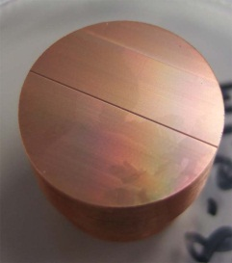
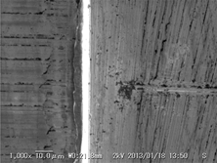
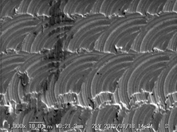
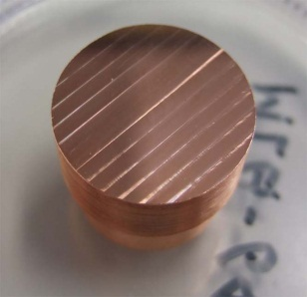
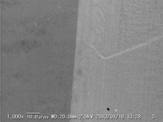
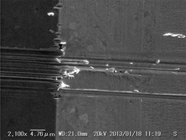
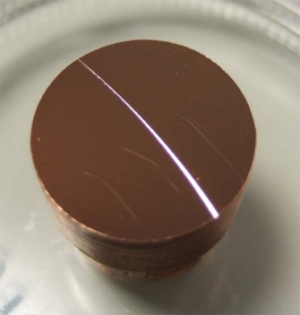
Copper surface study underway
End mill
Ball point end mill
Scratch by profilemeter
Turning lathe
We want SLAC to apply the chemical process and heat treatment.

Slide 19
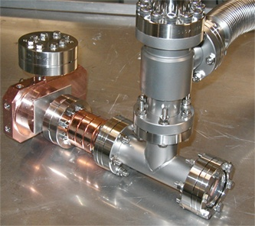
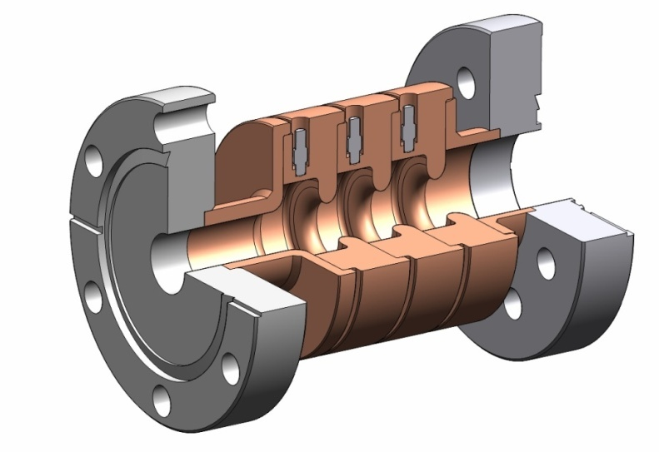
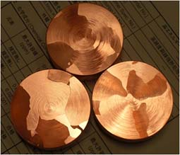
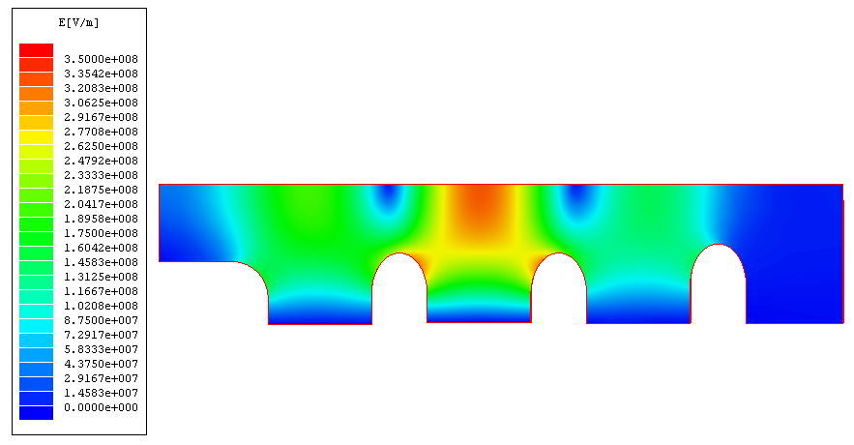
Basic study setups
Clean setup
High field only at center cell
Large grain material
Simple crystal characteristics

Slide 20
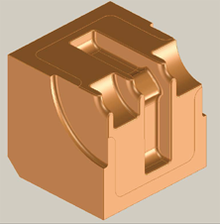
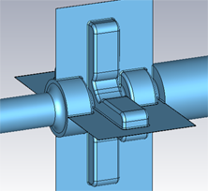
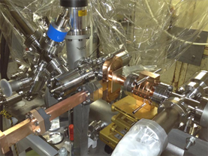
Quad with large Chamfer (R=400μm) with single-cell setup
0.1mm gap
between
facing planes
R=400μm
(Round Chamfer)
Shield-B
To understand why quad-type does not perform well under high gradient and possibly cure the problem!?

Slide 21
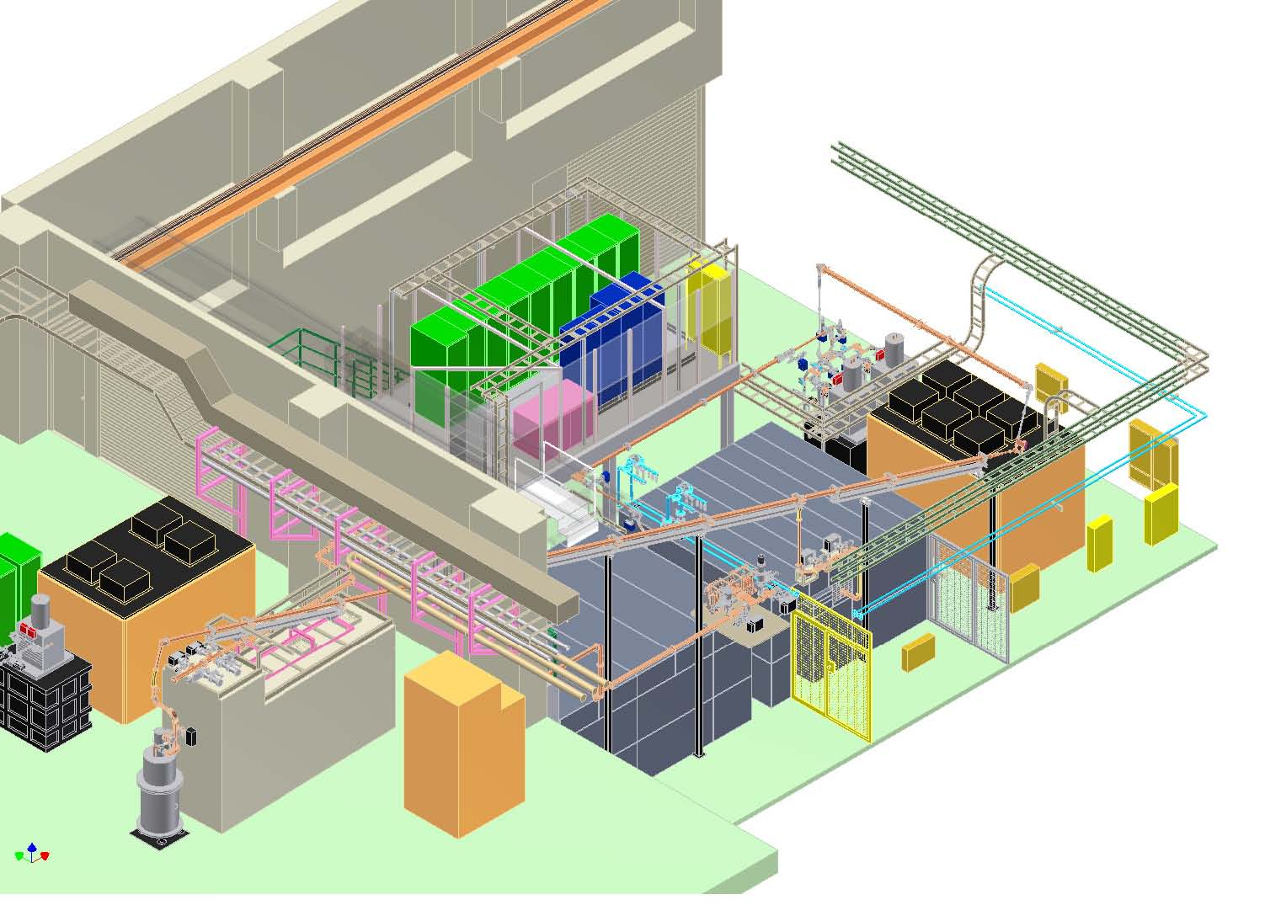
Nextef two test stations
Shield “A” for prototype tests.
Shield “B” for basic tests
Nextef
X-band
KT-1
X-band
B
A
Notes:
基礎試験設備 ＠KEK

Slide 22
US pursuits studies for much higher gradient
Mostly studied by SLAC and US side
Some topics are
  Hard copper study
  SW approach
  Dielectric loaded structure
  PBG structure
  Low temperature study
  Very high frequency
  High efficiency high power devices
  Blues have been those under US-Japan collaboration.

Slide 23
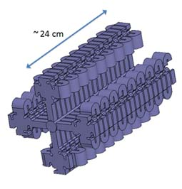
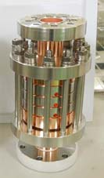
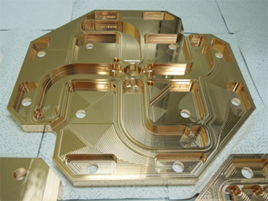
SLAC study toward much higher gradient
CuAg clamped
SW cavity
Notes:
SLACで進めている SW ベースの設計
今後 高電界試験へ進めていく

Slide 24
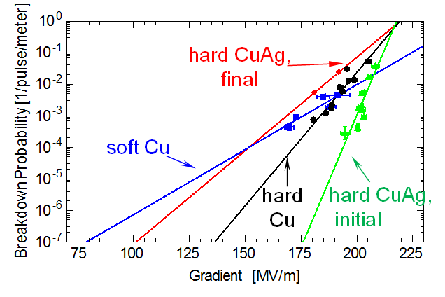
Can we operate at 175 MV/m??
Hard copper seems different from usual OFC.
Need to study more carefully, especially long-term stability, but proof of principle seems shown.

Slide 25
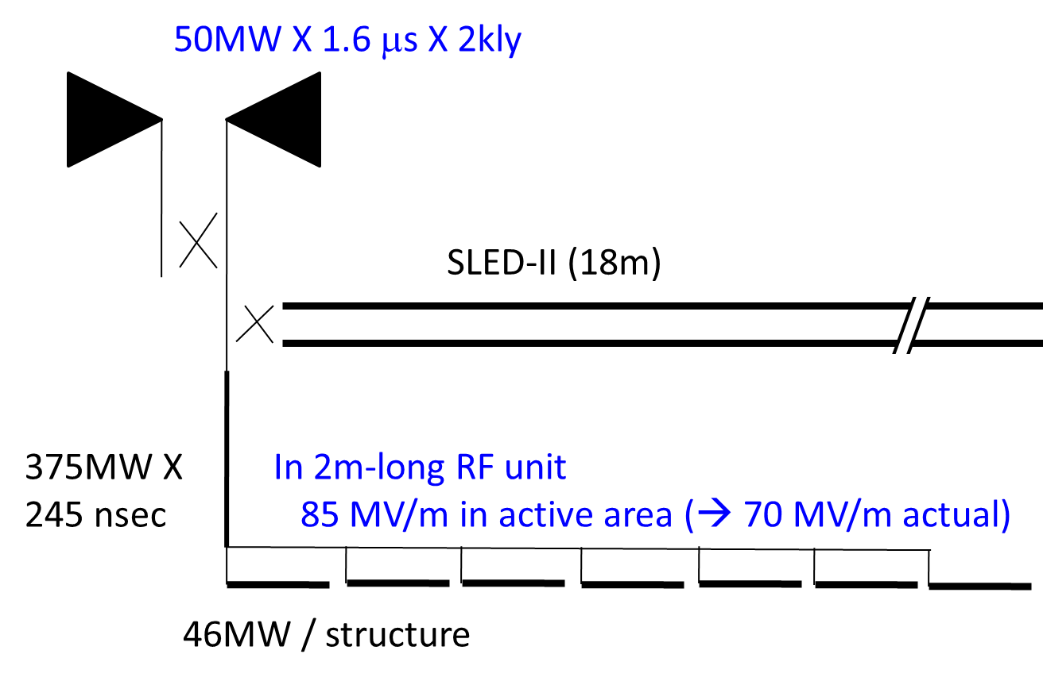
Klystron-based linear collider
2m RF unit configuration
presented at Higgs factory (Nov. 2012, FNAL)
RF system can be the same as GLC/NLC but at higher gradient. Question is optimization of RF power source size.

Slide 26
Conclusion for JFY2013 proposal
JFY2011:
80MV/m was found feasible in copper structure, TD24.
Magnetic field and associated high current on a crystal structure play an important role.
JFY2012:
Continue prototype structure fabrication and test.
Prepared test facility with simple geometries at Shield-B in KEK.
JFY2013:
Obtain better physics understanding on breakdown trigger.
Extensively pursuit tests with simple geometries.
Continue prototype structure fabrication and test.
Propose a possible RF system for high energy machine.
Background:
US pursuits real high gradient while Japan evaluates below 100 MV/m. These studies are complementally and offer a basic idea for high energy machine.
Notes:
これまでの3年間
今後の3年間
基礎研究
放電の理解
100MV/m超の加速の可能性

